Slide 1
Intro To ML
Course Code - CS422

Slide 2
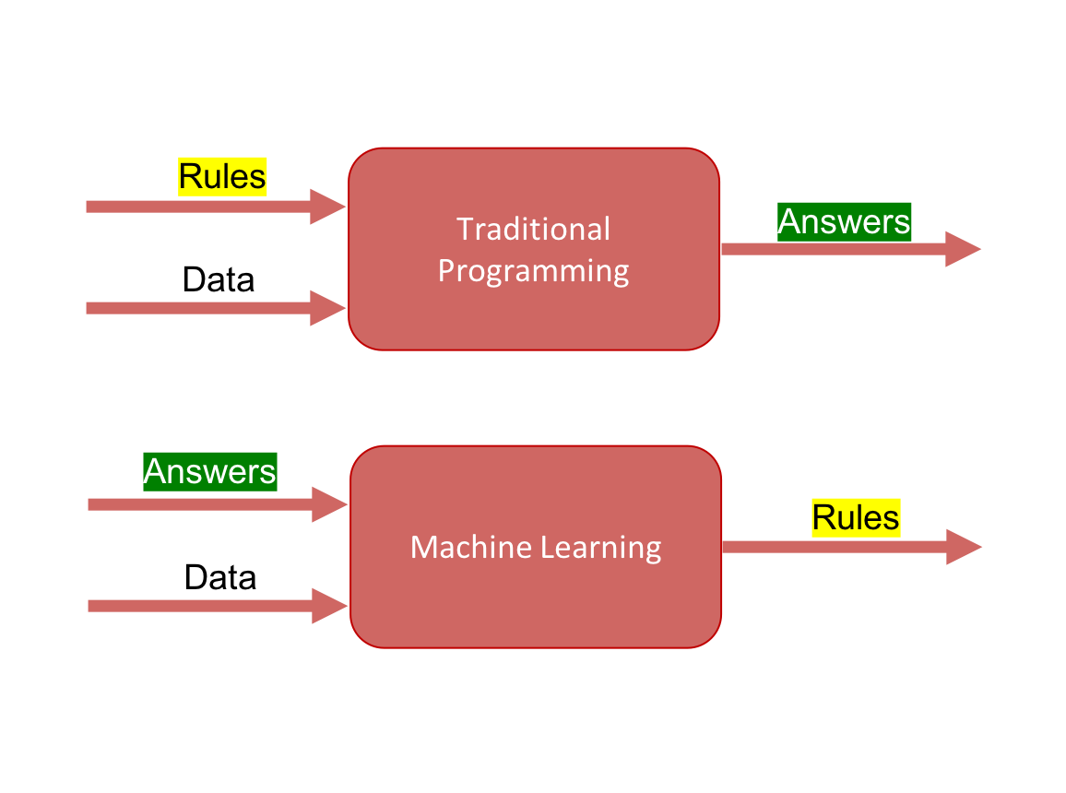
Traditional Learning vs Machine Learning

Slide 3
Our Dataset?
Features → CGPA Target Label → Good / Average Students

Slide 4
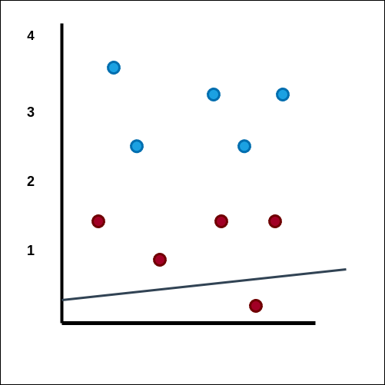
Training Phase Starts
Goal - The line (is the rule) which separates the two labels (good and average) students
Blue - Good Students Red - Average Students
Formulae of a straight line: Y = mx + c .

Slide 5
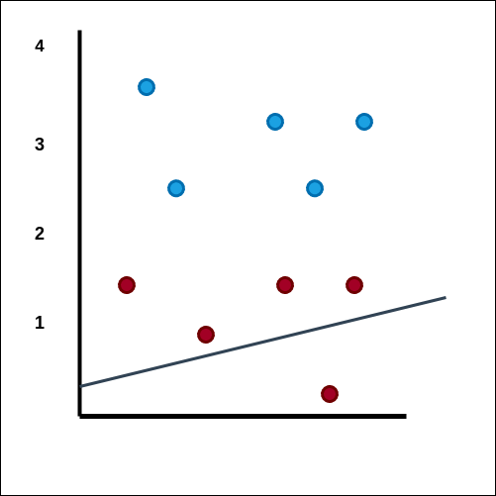

Slide 6
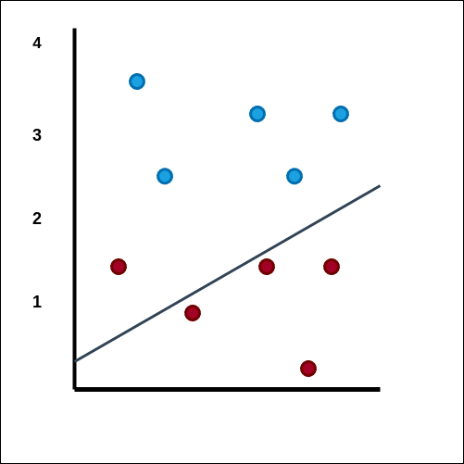

Slide 7
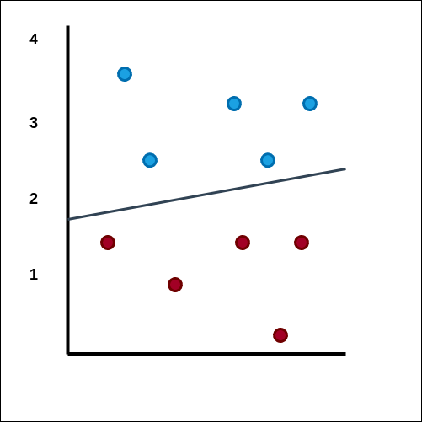

Slide 8
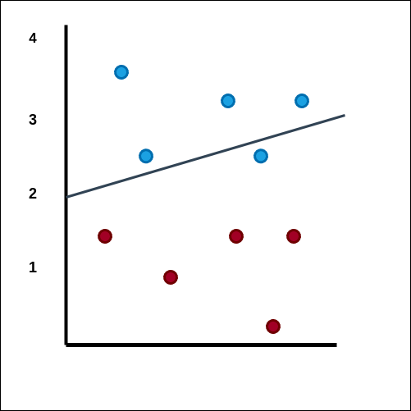

Slide 9
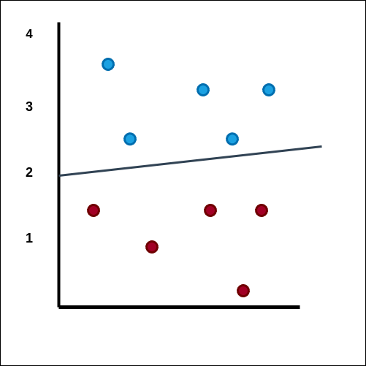
Here, value of m and c changes so that our line splits the different
labels into two different groups.
Training COMPLETE

Slide 10
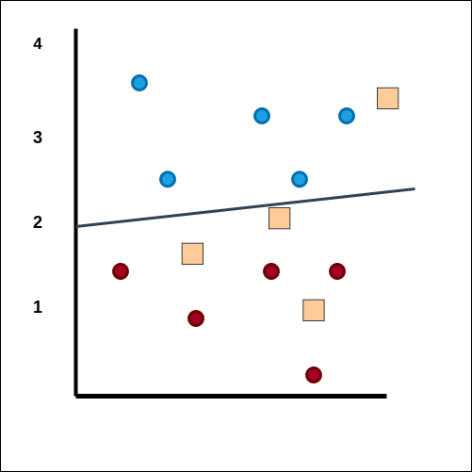
Testing Phase Begins

Slide 11
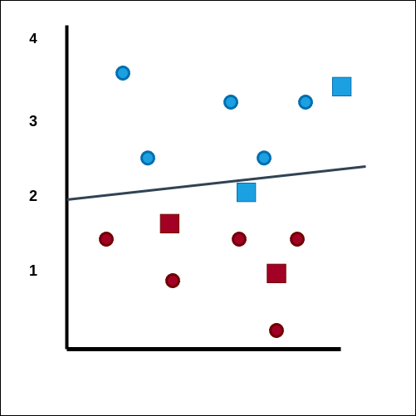
Calculate the accuracy.

Slide 12
Why do we need preprocessing
Raw data has many issues such as null values.
Textual Data that machines can not understand
Not scaled data
After PREPROCESSING, we feed this data to the model to train - test

Slide 13
Train vs Test Phase
Train the model to learn the parameters
Test with unseen data to measure performance of the model

Slide 14
Types of machine Learning
Supervised Learning
Unsupervised Learning

Slide 15
Supervised Learning
Classification
Regression

Slide 16
Classification
Binary (Two classes). Eg - True or False, Yes or No.
Multi Classification (More than two classes).
Eg - Best, Average or Bad. Large, Medium or Small.

Slide 17
Machine Learning
Supervised
Unsupervised
Classification
Regression
Binary
Multi-Class

Slide 18
Input vs Output
Input - Feature Variables
Output - Target variables / Target Labels

Slide 19
Different types of dataset
Tabular Dataset
Image (computer vision)
Text or speech related (NLP)

Slide 20
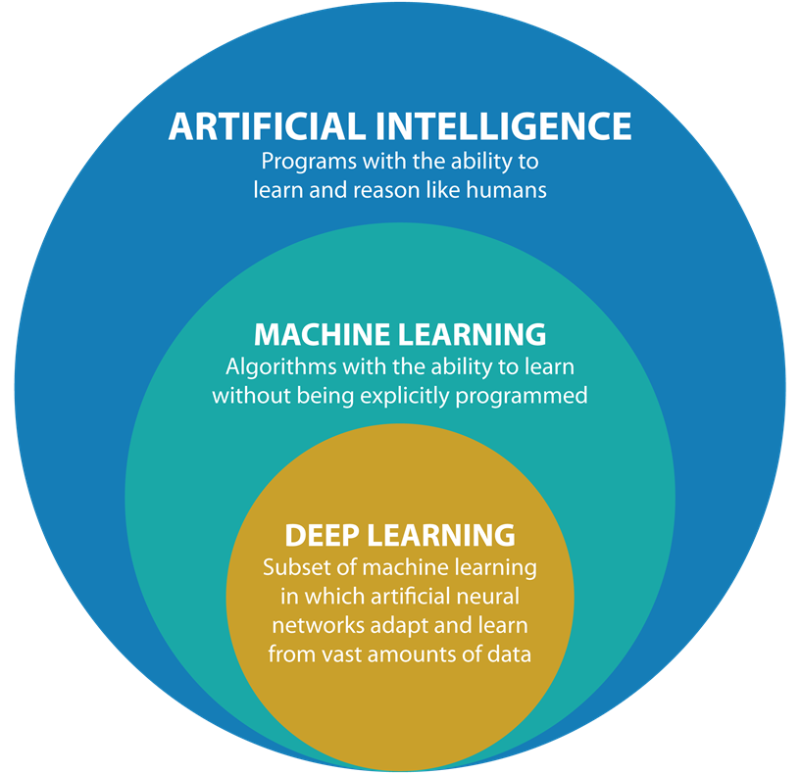

Slide 21
The End

